Slide 1

Budget Impact Analysis (BIA) Methods & Scenario
Paul Gerardo Yeh, MD, DrPH
MPACH Department
3915 Course
October 31, 2023

Slide 2
Contents
Framework for thinking “Budget Impact Analysis”
Budget Impact Analysis
Decision modeling: Designing Budget Impact Analysis
Framing: Conceptualize the problem
Structure
Parameters: probability and cost
Evaluation
Uncertainty (Test assumption)
CHEERS Publication standard
Economic Evaluation Review
Budget Impact Analysis
Decision Modeling
BIA Analysis Framing
BIA Analysis Structure
BIA Parameters and Evaluation
Sensitivity Analyses

Slide 3
Economic evaluation
Comparison of alternative options in terms of their costs and consequences (Drummond et al. 2005)
Alternative options – ‘technology’ , ‘program’ , or ‘intervention’ in which health care resources can be used to increase population health.
E.g. pharmaceutical and surgical interventions, screening and health promotion programs
Costs
Health care - Value of tangible resources available to the healthcare system.
Clinical and other staff, capital equipment and buildings, and consumable drugs
Non-health care – Resources used to produce health care
Time of patients and their families
Effects – health effects of treatment options, changes in individuals’ health
Economic Evaluation Review
Budget Impact Analysis
Decision Modeling
BIA Analysis Framing
BIA Analysis Structure
BIA Parameters and Evaluation
Sensitivity Analyses

Slide 4
Economic evaluation (REVIEW)
Type of economic evaluation (how to report costs and consequences)
Cost-analysis – reporting costs by intervention
Cost-minimization analysis – reporting costs to achieve same outcome, which is for minimization of cost
Cost-benefit analysis – reporting monetary value on the health outcomes, how much in total it is worth spending on an alternative given its projected effects
Cost-effectiveness analysis – reporting cost per unit of health outcome, incremental costs/effects, and ICER, resource allocation decision across different areas of health care
Cost-utility analysis – reporting cost per QALY gained (effects on survival measured in terms of life-years, and its effect on quality of life)
Budget impact analysis - ?
Economic Evaluation Review
Budget Impact Analysis
Decision Modeling
BIA Analysis Framing
BIA Analysis Structure
BIA Parameters and Evaluation
Sensitivity Analyses
4

Slide 5
Economic evaluation
Connection between Cost-benefit and Cost-effectiveness/cost-utility analysis
CEA/CUAs compare ICERs to some threshold, which traditionally is measured in terms of years of life gained or quality-adjusted life years (QALY)
Threshold is the maximum WTP (willingness to pay) per unit of life or QALY
WTP depends on income and GDP
E.g. In US-based cost-utility analyses, 77.5% of all authors use either 50,000$ USD or 100,000$ USD per QALY as a reference point for cost-effectiveness*
After CEA/CUA:
If we have a new intervention that is considered cost-effective, what next?
ICER compared to traditional care is within WTP e.g. $35,000 per QALY. Do we implement?
The recommendation is to implement the intervention
The next logical question should be: can we afford it?
*Neumann PJ, Cohen JT, Weinstein MC. Updating cost-effectiveness — the curious resilience of the $50,000-per-QALY threshold. N Engl J Med. 2014;371:796–797.
Economic Evaluation Review
Budget Impact Analysis
Decision Modeling
BIA Analysis Framing
BIA Analysis Structure
BIA Parameters and Evaluation
Sensitivity Analyses
Notes:
CBA measures the benefits of an intervention in monetary units (Net Social Benefits, NSBi = Bi − Ci)
The decision rule is that the intervention should be implemented if Bi > Ci
Ethical concerns
“The major disadvantage of the benefit-cost framework is the requirement that human lives and quality of life be valued in monetary units. Many decision-makers find this difficulty or unethical or do not trust analyses that depend upon such valuations. (Weinstein and Fienberg, 1980)
Given the difficulties of valuing outcomes, CBA is not often used in economic evaluations
If new surgical procedure reduces operative mortality by 5%, CBA will estimate if each death averted had a value of $500, and then assess whether the monetary value of the benefits was greater or less than the cost of obtaining theses benefits

Slide 6
Economic evaluation
Connection between Cost-benefit and Cost-effectiveness/cost-utility analysis
CBA measures the benefits of an intervention in monetary units (Net Social Benefits, NSBi = Bi − Ci)
The decision rule is that the intervention should be implemented if Bi > Ci
Ethical concerns
“The major disadvantage of the benefit-cost framework is the requirement that human lives and quality of life be valued in monetary units. Many decision-makers find this difficulty or unethical or do not trust analyses that depend upon such valuations. (Weinstein and Fienberg, 1980)
Given the difficulties of valuing outcomes, CBA is not often used in economic evaluations
If new surgical procedure reduces operative mortality by 5%, CBA will estimate if each death averted had a value of $500, and then assess whether the monetary value of the benefits was greater or less than the cost of obtaining theses benefits
Economic Evaluation Review
Budget Impact Analysis
Decision Modeling
BIA Analysis Framing
BIA Analysis Structure
BIA Parameters and Evaluation
Sensitivity Analyses

Slide 7
Budget impact analysis
Budget impact analysis - Economic assessment to predict the financial consequences of the adoption of a new health care intervention within a specific health care setting given resource constraints
While BIAs focus on the financial impact of the new interventions (drugs, health program), the value to the overall healthcare system is examined through other economic analyses, such as cost-effectiveness analyses (CEAs).
Economic Evaluation Review
Budget Impact Analysis
Decision Modeling
BIA Analysis Framing
BIA Analysis Structure
BIA Parameters and Evaluation
Sensitivity Analyses
7

Slide 8
Budget impact analysis
BIA is usually performed in addition to CEA (Complement of CEA, not substitute)
BIAs answer affordability, “Can we implement it?,” based on budget
To understand the total budget
To inform influential implementation decision (Unit cost x target population)
How much their net annual budget is likely to increase/decrease by the new intervention in year 1, 2, and 3?
BIA is a financial decision (resource allocation purpose)
Emphasize ‘relevance (timeliness)’ of information -> Short-term analysis
Economic Evaluation Review
Budget Impact Analysis
Decision Modeling
BIA Analysis Framing
BIA Analysis Structure
BIA Parameters and Evaluation
Sensitivity Analyses
8

Slide 9
Budget impact analysis
Growing recognition (ISPOR task force, Sullivan and Mauskopf et al, 2014)
“Budget impact analysis (BIA) is an essential part of a comprehensive economic assessment of a health-care technology and is increasingly required, along with cost-effectiveness analysis (CEA), before formulary approval or reimbursement.”
National regulatory agencies (Sullivan and Mauskopf et al, 2014)
National Institute for Clinical Excellence (NICE) in England and Wales
Pharmaceutical Benefits Advisory Committee (PBAC) in Australia
Managed care organizations (MCOs) in the USA
Economic Evaluation Review
Budget Impact Analysis
Decision Modeling
BIA Analysis Framing
BIA Analysis Structure
BIA Parameters and Evaluation
Sensitivity Analyses
9

Slide 10
Budget impact analysis
The relevant question for a BIA study is the affordability of the interventions
Take into account the actual number of people that would be affected by intervention
Number of people * Cost per intervention
All the issues about perspective, time horizon, and relevance of costs for the decision are still valid.
Analysis of payer’s expenditures for new intervention (drug, program or technology) over a short period (1 to 3 years)
Economic Evaluation Review
Budget Impact Analysis
Decision Modeling
BIA Analysis Framing
BIA Analysis Structure
BIA Parameters and Evaluation
Sensitivity Analyses
10

Slide 11
Budget impact analysis
 | BIA | CEA
Information | Affordability | Value for money
Purpose | Financial impact of new intervention | Efficiency of alternatives
Time horizon | Short-term (1 to 5 years) | Long-term (life-time)
Perspective | Payer | Societal
Outcomes | Excluded | QALYs (quality-adjusted life years)
Discounting | No | 4%
Results | Total and incremental annual costs | Incremental cost per unit
Economic Evaluation Review
Budget Impact Analysis
Decision Modeling
BIA Analysis Framing
BIA Analysis Structure
BIA Parameters and Evaluation
Sensitivity Analyses
11
11

Slide 12
Budget impact analysis
Preferred comparators
Routine care vs. New/Intensive/Advanced intervention
BIA topics (to address affordability)
Targeted drug therapy to adjuvant therapy
Routine to intensive cancer surveillance
Traditional to digital cancer screening
On-site to telemedicine care
Open surgery vs. Robotic surgery
Economic Evaluation Review
Budget Impact Analysis
Decision Modeling
BIA Analysis Framing
BIA Analysis Structure
BIA Parameters and Evaluation
Sensitivity Analyses
12

Slide 13
Budget impact analysis
BIA Example
Routine/usual cancer care
Patients visit (Asymptomatic/Symptomatic) - Screening – Diagnostic procedure - Treatment
Intensive cancer prevention program by adding promotional elements significantly increased early detection and timeliness treatment
‘outreach’ to population at risk of specific cancer
‘education’ to inform how to receive screening and why it is important
‘reminder’ by sending letters to receive screening
Intensive program was cost-effective, and now Public Health Officers are interested in implementing this program for community/city/state
Economic Evaluation Review
Budget Impact Analysis
Decision Modeling
BIA Analysis Framing
BIA Analysis Structure
BIA Parameters and Evaluation
Sensitivity Analyses
13

Slide 14
Decision modeling
How to design budget impact analysis?
We can not just guess. We need to apply modeling to estimate accurate financial consequences after implementation
Decision modeling is a set of analytic tools of economic evaluation
Framework to inform decision making under conditions of uncertainty
Widely used in a range of disciplines including business analysis, engineering, or healthcare evaluation in terms of informing clinical decisions at population and individual levels
Economic Evaluation Review
Budget Impact Analysis
Decision Modeling
BIA Analysis Framing
BIA Analysis Structure
BIA Parameters and Evaluation
Sensitivity Analyses
14

Slide 15
Decision modeling
We need a systematic approach to decision making under uncertainty
Mathematical relationships to define a series of possible consequences that would flow from a set of alternative options being evaluated
Decision analysis is a quantitative description of the various choices and possible outcomes in a specific clinical situation
The important distinction in structuring problems as decision analyses is the term quantitative
This analytic technique requires that specific values be placed on the different possible outcomes so that an answer can be obtanined
Economic Evaluation Review
Budget Impact Analysis
Decision Modeling
BIA Analysis Framing
BIA Analysis Structure
BIA Parameters and Evaluation
Sensitivity Analyses
15

Slide 16
Decision modeling
Decision analysis as a formal analytic framework was developed over 70 years ago for the making of decisions under conditions of uncertainty
Was initially applied in other areas of interest
Risk portfolio theory
Natural resource exploration
Economic Evaluation Review
Budget Impact Analysis
Decision Modeling
BIA Analysis Framing
BIA Analysis Structure
BIA Parameters and Evaluation
Sensitivity Analyses
16

Slide 17
Decision modeling: 1940s
Questions for Royal Air Force (RAF) to rescue for pilots lost in the North Sea
Given last known position and accuracy
Given water temperature
Given weather
At what altitude should search planes fly?
Fly higher:
Cover more ground but might miss the pilot
Fly lower:
More accurate search, but search smaller amount of sea and increasing probability of enemy fire.
Longer you search: decreasing probability of finding pilot alive
Economic Evaluation Review
Budget Impact Analysis
Decision Modeling
BIA Analysis Framing
BIA Analysis Structure
BIA Parameters and Evaluation
Sensitivity Analyses
17

Slide 18
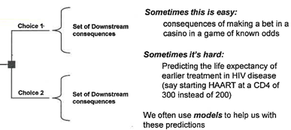
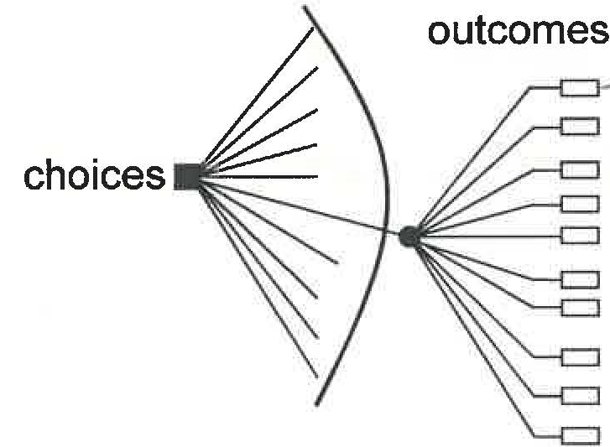
Decision modeling
Consider a range of possible choices, each choice with a range of possible outcomes
Problem is to understand the expected value of the outcome given various choices
The purpose of a decision model is to estimate the effects of choices in a decision making context
Economic Evaluation Review
Budget Impact Analysis
Decision Modeling
BIA Analysis Framing
BIA Analysis Structure
BIA Parameters and Evaluation
Sensitivity Analyses
18

Slide 19
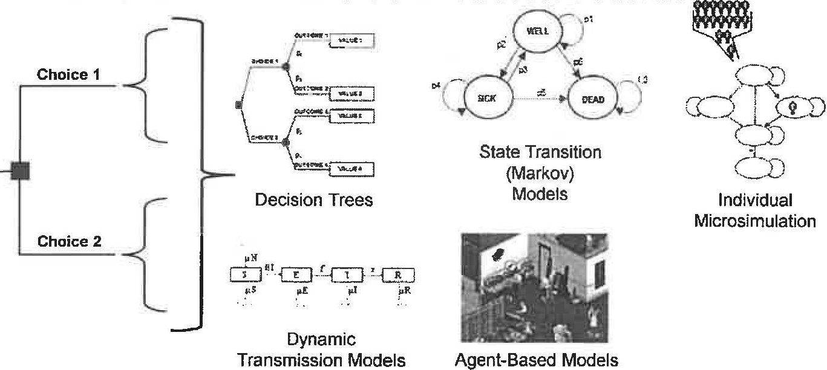
Decision modeling
There are many types of modeling methods on can use to estimate downstream events:
Economic Evaluation Review
Budget Impact Analysis
Decision Modeling
BIA Analysis Framing
BIA Analysis Structure
BIA Parameters and Evaluation
Sensitivity Analyses
19

Slide 20
Decision modeling
Step 1: Frame the question
Step 2: Structure process
Step 3: Estimate the probabilities
Step 4: Estimate the costs
Step 5: Analysis
Step 6: Test assumptions
Step 7: Interpret results
Economic Evaluation Review
Budget Impact Analysis
Decision Modeling
BIA Analysis Framing
BIA Analysis Structure
BIA Parameters and Evaluation
Sensitivity Analyses
20

Slide 21
Framing: conceptualize the problem
Feature of healthcare delivery system
Scope and structure
E.g. Affordability to implement a prevention program to increase screening rate, early detection, initiate timeliness treatment, and decrease mortality
Payer perspective of the analysis
Public health provider/program who will pay for interventions
Inclusion | Exclusion
Provider’s costs (direct costs) Intervention cost Staff cost Supplies | Patient’s costs (Societal costs) Transportation cost Opportunity cost
Economic Evaluation Review
Budget Impact Analysis
Decision Modeling
BIA Analysis Framing
BIA Analysis Structure
BIA Parameters and Evaluation
Sensitivity Analyses
21

Slide 22
Framing: conceptualize the problem
Target population
Size and characteristics of affected population (hypothetical population)
Estimates of eligible population (age, gender, stage, comorbidity, insurance status)
Data source (Budget holder, relevant epidemiologic studies, socioeconomic factors, or statistics)
e.g. Program for uninsured aged 50-75 Hispanic in greater Houston area
We can estimate the hypothetical target population (7,000,000*0.4*0.2*0.3)
Characteristics | Data
Total population | 7,000,000
Hispanic | 40%
Age 50 to 75 | 20%
Uninsured | 30%
Possible source: US Cancer Statistics Working Group, U.S. Census Bureau
Economic Evaluation Review
Budget Impact Analysis
Decision Modeling
BIA Analysis Framing
BIA Analysis Structure
BIA Parameters and Evaluation
Sensitivity Analyses
22

Slide 23
Framing: conceptualize the problem
Time horizon is a short period (Usually 3 years or 5 years)
No inflation or discounting (unlike in most CEA/CUA)
No cost offset by long-term effect
Treatment costs are usually skewed (Usually initial costs is highest)
Outcomes
No utility (Cost only)
May not capture non-monetary benefit ex) reputation, goodwill
Interventions or strategies (usual care vs. intensive care)
E.g. ‘outreach, ’education,’ ‘reminder’
Economic Evaluation Review
Budget Impact Analysis
Decision Modeling
BIA Analysis Framing
BIA Analysis Structure
BIA Parameters and Evaluation
Sensitivity Analyses
23

Slide 24
Framing: conceptualize the problem
 | BIA
Information | Affordability
Purpose | Financial impact of new intervention
Time horizon | Short-period
Perspective | Payer
Outcomes | Excluded
Discounting | No
Results | Total and incremental annual costs
Economic Evaluation Review
Budget Impact Analysis
Decision Modeling
BIA Analysis Framing
BIA Analysis Structure
BIA Parameters and Evaluation
Sensitivity Analyses
24

Slide 25
Budget impact analysis example
BIA Example
Routine/usual cancer care
Patients visit (Asymptomatic/Symptomatic) - Screening – Diagnostic procedure - Treatment
Intensive cancer prevention program by adding promotional elements significantly increased early detection and timeliness treatment
‘outreach’ to population at risk of specific cancer
‘education’ to inform how to receive screening and why it is important
‘reminder’ by sending letters to receive screening
Intensive program was cost-effective, and now Public Health Officers are interested in implementing this program
Economic Evaluation Review
Budget Impact Analysis
Decision Modeling
BIA Analysis Framing
BIA Analysis Structure
BIA Parameters and Evaluation
Sensitivity Analyses
25

Slide 26
Framing : conceptualize problem
Intensive intervention
(Outreach, education, reminder, enrollment support,,,)
Usual care
Visit
Symptomatic/asymptomatic
Screening
Primary/Secondary
Diagnosis
Biopsy
Pathology
Treatment
Chemo
Surgery
Diagnostic procedure
Economic Evaluation Review
Budget Impact Analysis
Decision Modeling
BIA Analysis Framing
BIA Analysis Structure
BIA Parameters and Evaluation
Sensitivity Analyses
26

Slide 27
Structure process
Model is designed based on the scenario (clinical process, natural history of cancer)
TreeAge, Excel
Simple tree-model
Static model contains a simple calculation by simple changes with well known probabilities given others constant
Markov model
Dynamic model is required for a complex scenario with sensitivity analysis to capture uncertainty
Economic Evaluation Review
Budget Impact Analysis
Decision Modeling
BIA Analysis Framing
BIA Analysis Structure
BIA Parameters and Evaluation
Sensitivity Analyses
27

Slide 28
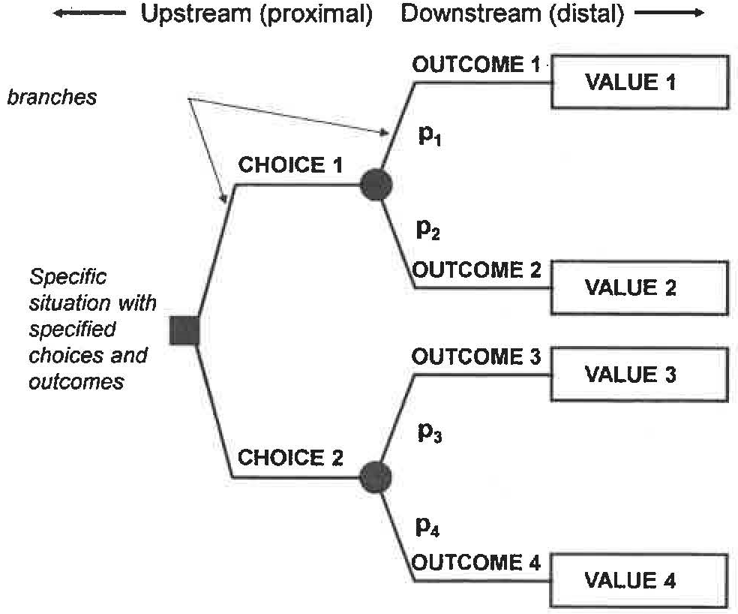
Structure
Basic component of tree model
We design a model to downstream based on the scenario (clinical process)
The model rolls back (upstream) values to compare choice 1 and choice 2
Economic Evaluation Review
Budget Impact Analysis
Decision Modeling
BIA Analysis Framing
BIA Analysis Structure
BIA Parameters and Evaluation
Sensitivity Analyses
28

Slide 29
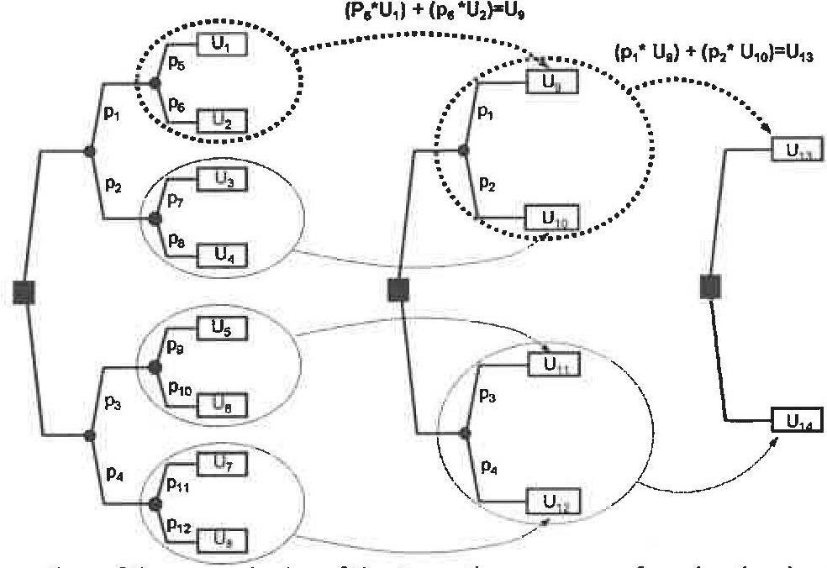
Structure
The process of evaluation is straightforward in the tree model
Starting at the right hand side of the tree, replace each chance node with its expected value, until the only branch left are the decision nodes
Economic Evaluation Review
Budget Impact Analysis
Decision Modeling
BIA Analysis Framing
BIA Analysis Structure
BIA Parameters and Evaluation
Sensitivity Analyses
29

Slide 30
Structure
How complex should I model be?
Simple model may miss clinically or policy important attributes
May be easy to design and run
May get wrong answer
May have no clinical credence with content experts
Make it difficult to test robustness in assumptions
Complex model
Difficult to develop and run
May require data so specific it is unavailable
May be difficult to understand by non-quantitative people
But accurately reflect the clinical conditions or situation a decision
Economic Evaluation Review
Budget Impact Analysis
Decision Modeling
BIA Analysis Framing
BIA Analysis Structure
BIA Parameters and Evaluation
Sensitivity Analyses
30

Slide 31
Structure
Cancer prevention in usual care
Visit healthcare provider to receive screening with/without symptom
Receive screening
Positive? Negative?
If negative, receive another screening after 3 years
If positive, receive diagnostic procedure
Positive? Negative?
.
.
.
Economic Evaluation Review
Budget Impact Analysis
Decision Modeling
BIA Analysis Framing
BIA Analysis Structure
BIA Parameters and Evaluation
Sensitivity Analyses
31

Slide 32
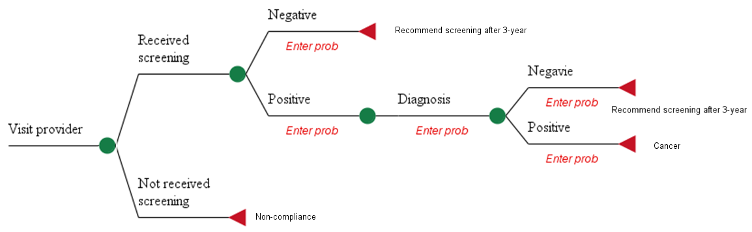
Structure
Clinical process in usual care
Economic Evaluation Review
Budget Impact Analysis
Decision Modeling
BIA Analysis Framing
BIA Analysis Structure
BIA Parameters and Evaluation
Sensitivity Analyses
32

Slide 33
Structure
Clinical process in intensive care
Outreach to the public fair or healthcare providers. Provide gift card and transportation costs if they agree to participate in the program
Educate participants using flip-chart about how to receive screening
Receive screening?
If not, send a reminder letter or calls
Positive? Negative?
If negative, receive another screening after 3 years
If positive, receive diagnostic procedure
.
.
.
Economic Evaluation Review
Budget Impact Analysis
Decision Modeling
BIA Analysis Framing
BIA Analysis Structure
BIA Parameters and Evaluation
Sensitivity Analyses
33

Slide 34
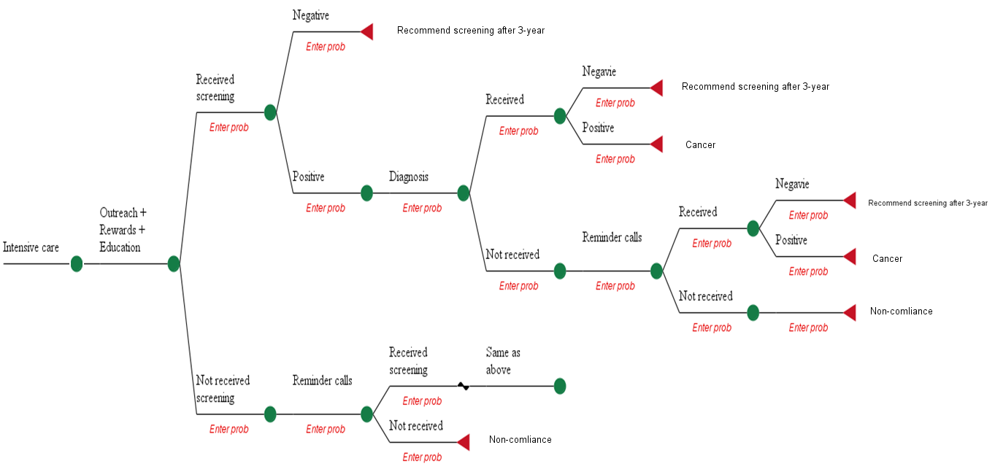
Economic Evaluation Review
Budget Impact Analysis
Decision Modeling
BIA Analysis Framing
BIA Analysis Structure
BIA Parameters and Evaluation
Sensitivity Analyses
34

Slide 35
Estimate the probabilities/costs
Data sources
Literature
Clinical data (screening rate, detection rate, stage, vital)
EHR
Clinical trials (survival, treatment, surveillance)
Pharmaceutical companies - ClinicalTrial.gov, Clinical Data Interchange Standard Consortium (CDISC)
Patient-recorded data (screening adherence)
Smart health, digital health, mobile health
Social/demographic determinant data (hypothetical population)
Claim data (cost of provided procedures, health services )
Insurance company, Medicare, Medicaid
Administrative data
Invoice/bills, labor costs ((salary + fringe benefit –vacation)*productivity rate )
Economic Evaluation Review
Budget Impact Analysis
Decision Modeling
BIA Analysis Framing
BIA Analysis Structure
BIA Parameters and Evaluation
Sensitivity Analyses
35

Slide 36
Estimate the probabilities/costs
Probabilities
Screening rates
Positive/negative rate
Diagnosis rate
Normal/abnormal
Detection rate
Cost elements
Outreach (transportation, recruiter, rewards)
Education (flip charts, educator)
Reminder (letter stamp, calls, caller)
Electricity
Physician charges (screening, diagnosis)
Facility charges (Utility)
Administrative (manager)
Economic Evaluation Review
Budget Impact Analysis
Decision Modeling
BIA Analysis Framing
BIA Analysis Structure
BIA Parameters and Evaluation
Sensitivity Analyses
36

Slide 37
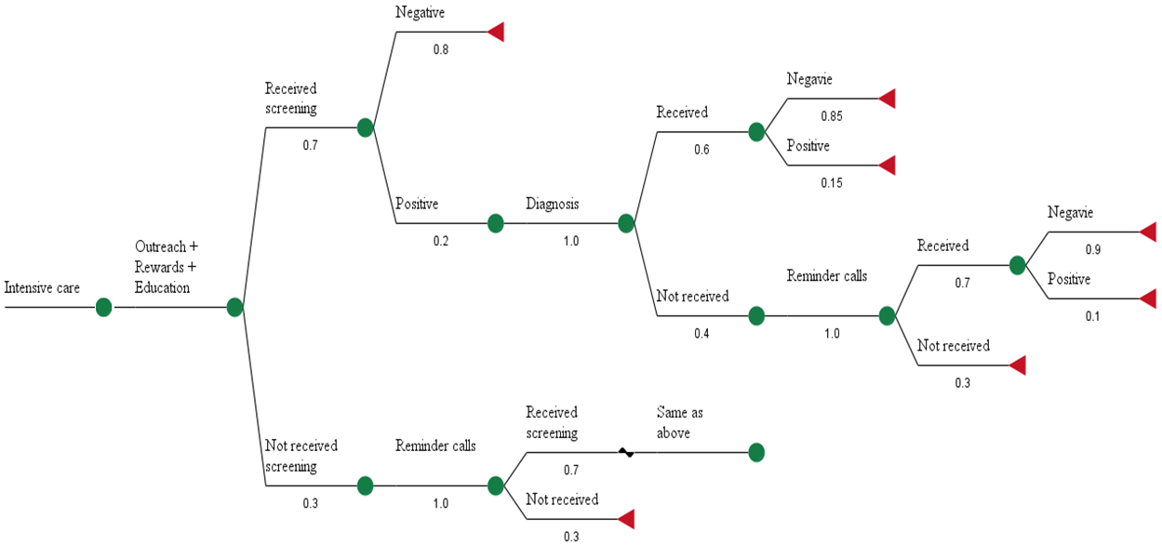
Economic Evaluation Review
Budget Impact Analysis
Decision Modeling
BIA Analysis Framing
BIA Analysis Structure
BIA Parameters and Evaluation
Sensitivity Analyses
37

Slide 38
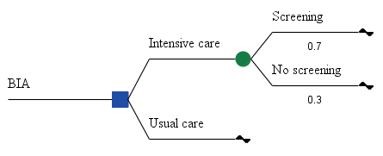
Evaluate the tree
Average out/roll back
This result will show the total and incremental costs of program implementation for intensive care vs. usual care.
Economic Evaluation Review
Budget Impact Analysis
Decision Modeling
BIA Analysis Framing
BIA Analysis Structure
BIA Parameters and Evaluation
Sensitivity Analyses
38

Slide 39
Reporting
Budget of status quo vs. intervention for hypothetic population over 3 years
Comprehensive budget
Incremental and cumulative budget for each year, average, and per person
Economic Evaluation Review
Budget Impact Analysis
Decision Modeling
BIA Analysis Framing
BIA Analysis Structure
BIA Parameters and Evaluation
Sensitivity Analyses
39

Slide 40
Test assumption (Sensitivity analysis)
Test the robustness of your results
Each parameter input into your model has ranges of uncertainty (Different data sources)
Cost of intervention may have a variation by physician, provider, or geographical location
Key parameters (cost drivers) with high sensitivity to budget (Which parameter is influential to the budget?)
Cost may be varied by geographic location or insurer
Improve the reliability and relevance for decision-making
Improve the understanding of applicability for other health system settings
Economic Evaluation Review
Budget Impact Analysis
Decision Modeling
BIA Analysis Framing
BIA Analysis Structure
BIA Parameters and Evaluation
Sensitivity Analyses
40

Slide 41
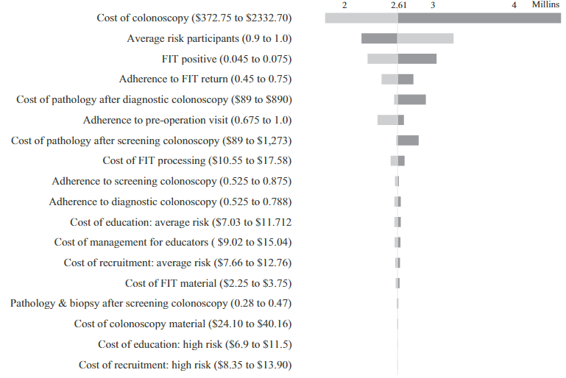
Test assumption (Sensitivity analysis)
Change assumptions in the model and see how the final outcome changes
Ex) ±25% of parameter, high-low method (historical data)
One-way
Change one at time
Easy, used to understand which variable has a sensitivity
Multiple-way (Tornado diagram)
Change multiple assumption at once, a set of one-way analysis
Scenario analysis
Basic vs. worst vs. best
Ex) Adherence rate of intervention
Economic Evaluation Review
Budget Impact Analysis
Decision Modeling
BIA Analysis Framing
BIA Analysis Structure
BIA Parameters and Evaluation
Sensitivity Analyses
41

Slide 42
Test assumption (Validation)
Determine face validity through agreement with relevant decision makers on the computing framework, aspects included, and how they are addressed (e.g., access restrictions and time horizon)
Verification of the cost calculator or model implementation, including all formulas
Economic Evaluation Review
Budget Impact Analysis
Decision Modeling
BIA Analysis Framing
BIA Analysis Structure
BIA Parameters and Evaluation
Sensitivity Analyses
42

Slide 43
Consolidated Health Economic Evaluation Reporting Standards (CHEERS)
The aim of the CHEERS statement is to provide recommendations, in the form of a checklist, to optimize reporting of health economic evaluations
Primary audiences for the CHEERS statement are researchers reporting economic evaluations and the editors and peer reviewers evaluating their publication potential
Clearly state the study question and its importance to decision makers
Don Husereau, Michael Drummond, Stavros Petrou, Chris Carswell, David Moher, Dan Greenberg, Federico Augustovski, Andrew H Briggs, Josephine Mauskopf, Elizabeth Loder. RESEARCH METHODS & REPORTING - Consolidated Health Economic Evaluation Reporting Standards (CHEERS) statement. BMJ 2013;346 :f1049
Economic Evaluation Review
Budget Impact Analysis
Decision Modeling
BIA Analysis Framing
BIA Analysis Structure
BIA Parameters and Evaluation
Sensitivity Analyses
43

Slide 44
Consolidated Health Economic Evaluation Reporting Standards (CHEERS)
Title | 1 | Identify the study as an economic evaluation or use more specific terms such as “cost-effectiveness analysis”, and describe the interventions compared.
Abstract | 2 | Provide a structured summary of objectives, perspective, setting, methods (including study design and inputs), results (including base case and uncertainty analyses), and conclusions.
Introduction
Background and objectives | 3 | Provide an explicit statement of the broader context for the study.
 |  | Present the study question and its relevance for health policy or practice decisions.
Economic Evaluation Review
Budget Impact Analysis
Decision Modeling
BIA Analysis Framing
BIA Analysis Structure
BIA Parameters and Evaluation
Sensitivity Analyses
44

Slide 45
Consolidated Health Economic Evaluation Reporting Standards (CHEERS)
Methods
Target population and subgroups | 4 | Describe characteristics of the base case population and subgroups analysed, including why they were chosen.
Setting and location | 5 | State relevant aspects of the system(s) in which the decision(s) need(s) to be made.
Study perspective | 6 | Describe the perspective of the study and relate this to the costs being evaluated.
Comparators | 7 | Describe the interventions or strategies being compared and state why they were chosen.
Time horizon | 8 | State the time horizon(s) over which costs and consequences are being evaluated and say why appropriate.
Discount rate | 9 | Report the choice of discount rate(s) used for costs and outcomes and say why appropriate.
Choice of health outcomes | 10 | Describe what outcomes were used as the measure(s) of benefit in the evaluation and their relevance for the type of analysis performed.
Measurement of effectiveness | 11a | Single study-based estimates: Describe fully the design features of the single effectiveness study and why the single study was a sufficient source of clinical effectiveness data.
 | 11b | Synthesis-based estimates: Describe fully the methods used for identification of included studies and synthesis of clinical effectiveness data.
Economic Evaluation Review
Budget Impact Analysis
Decision Modeling
BIA Analysis Framing
BIA Analysis Structure
BIA Parameters and Evaluation
Sensitivity Analyses
45

Slide 46
Consolidated Health Economic Evaluation Reporting Standards (CHEERS)
Measurement and valuation of preference based outcomes | 12 | If applicable, describe the population and methods used to elicit preferences for outcomes.
Estimating resources and costs | 13a | Single study-based economic evaluation: Describe approaches used to estimate resource use associated with the alternative interventions. Describe primary or secondary research methods for valuing each resource item in terms of its unit cost. Describe any adjustments made to approximate to opportunity costs.
 | 13b | Model-based economic evaluation: Describe approaches and data sources used to estimate resource use associated with model health states. Describe primary or secondary research methods for valuing each resource item in terms of its unit cost. Describe any adjustments made to approximate to opportunity costs.
Currency, price date, and conversion | 14 | Report the dates of the estimated resource quantities and unit costs. Describe methods for adjusting estimated unit costs to the year of reported costs if necessary. Describe methods for converting costs into a common currency base and the exchange rate.
Economic Evaluation Review
Budget Impact Analysis
Decision Modeling
BIA Analysis Framing
BIA Analysis Structure
BIA Parameters and Evaluation
Sensitivity Analyses
46

Slide 47
Consolidated Health Economic Evaluation Reporting Standards (CHEERS)
Choice of model | 15 | Describe and give reasons for the specific type of decision-analytical model used. Providing a figure to show model structure is strongly recommended.
Assumptions | 16 | Describe all structural or other assumptions underpinning the decision-analytical model.
Analytical methods | 17 | Describe all analytical methods supporting the evaluation. This could include methods for dealing with skewed, missing, or censored data; extrapolation methods; methods for pooling data; approaches to validate or make adjustments (such as half cycle corrections) to a model; and methods for handling population heterogeneity and uncertainty.
Economic Evaluation Review
Budget Impact Analysis
Decision Modeling
BIA Analysis Framing
BIA Analysis Structure
BIA Parameters and Evaluation
Sensitivity Analyses
47

Slide 48
Consolidated Health Economic Evaluation Reporting Standards (CHEERS)
Results
Study parameters | 18 | Report the values, ranges, references, and, if used, probability distributions for all parameters. Report reasons or sources for distributions used to represent uncertainty where appropriate. Providing a table to show the input values is strongly recommended.
Incremental costs and outcomes | 19 | For each intervention, report mean values for the main categories of estimated costs and outcomes of interest, as well as mean differences between the comparator groups. If applicable, report incremental cost-effectiveness ratios.
Characterising uncertainty | 20a | Single study-based economic evaluation: Describe the effects of sampling uncertainty for the estimated incremental cost and incremental effectiveness parameters, together with the impact of methodological assumptions (such as discount rate, study perspective).
 | 20b | Model-based economic evaluation: Describe the effects on the results of uncertainty for all input parameters, and uncertainty related to the structure of the model and assumptions.
Characterising heterogeneity | 21 | If applicable, report differences in costs, outcomes, or cost-effectiveness that can be explained by variations between subgroups of patients with different baseline characteristics or other observed variability in effects that are not reducible by more information.
Economic Evaluation Review
Budget Impact Analysis
Decision Modeling
BIA Analysis Framing
BIA Analysis Structure
BIA Parameters and Evaluation
Sensitivity Analyses
48

Slide 49
Consolidated Health Economic Evaluation Reporting Standards (CHEERS)
Discussion
Study findings, limitations, generalizability, and current knowledge | 22 | Summarise key study findings and describe how they support the conclusions reached. Discuss limitations and the generalisability of the findings and how the findings fit with current knowledge.
Other
Source of funding | 23 | Describe how the study was funded and the role of the funder in the identification, design, conduct, and reporting of the analysis. Describe other non-monetary sources of support.
Conflicts of interest | 24 | Describe any potential for conflict of interest of study contributors in accordance with journal policy. In the absence of a journal policy, we recommend authors comply with International Committee of Medical Journal Editors recommendations.
Economic Evaluation Review
Budget Impact Analysis
Decision Modeling
BIA Analysis Framing
BIA Analysis Structure
BIA Parameters and Evaluation
Sensitivity Analyses
49

Slide 50
Budget Impact Analysis
Question?
Reference:
Hoffmann C, Stoykova BA, Nixon J, Glanville JM, Misso, Drummond MF. Do health-care decision makers find economic evaluations useful? The findings of focus group research in UK health authorities. Value Health. 2002 Mar-Apr;5(2):71-8.
Sullivan SD, Mauskopf JA, Augustovski F, et al. Budget impact analysis-principles of good practice: report of the ISPOR 2012 Budget Impact Analysis Good Practice II Task Force. Value in health : the journal of the International Society for Pharmacoeconomics and Outcomes Research. 2014; 17: 5-14.
ISPOR 2013. Introduction to modeling methods

